Slide 1



Period | Tier Analysis | Geographic | Company
Customer Name
Customer #
Tier
State
Avg. Time On Dock (in hours): | 3 | Peer Avg. Time On Dock (in hours): | 3
Avg. Lbs Per Period: | 311,500 | Peer Avg. Lbs Per Period: | 311,500
Avg. # Of POs Per Load: | 2.9 | Peer Avg. # Of POs Per Load: | 2.9
Avg. Cases Per Load: | 1,684 | Peer Avg. Cases Per Load: | 1,684
Avg. Lines Per Load: | 182 | Peer Avg. Lines Per Load: | 182
Avg. Cases Per Line: | 9 | Peer Avg. Cases Per Line: | 9
Avg. % Item Spread: | 4% | Peer Avg. % Item Spread: | 4%

Slide 2
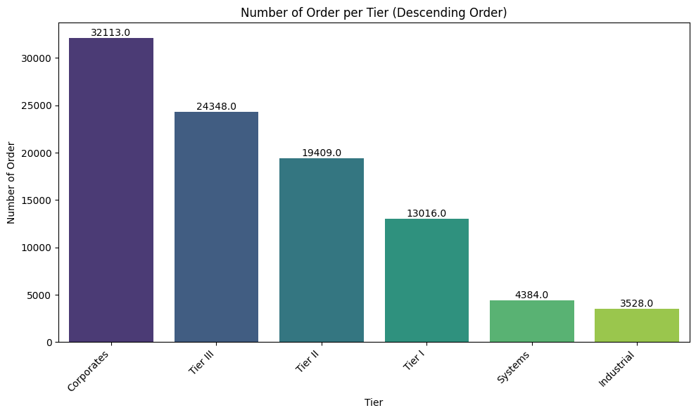
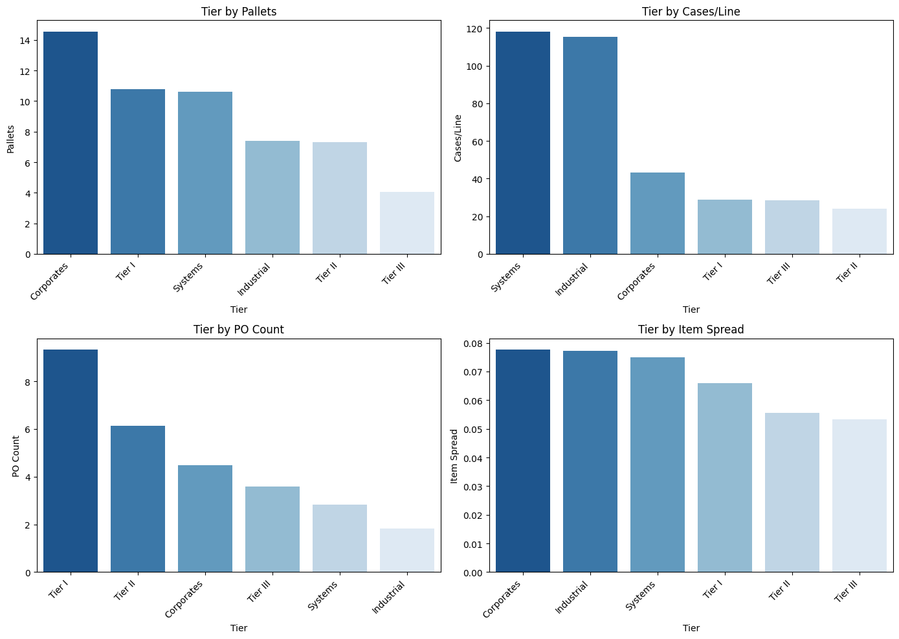
Company | Tier Analysis | Geographic | Company
Customer Name
Customer #
Tier
State
Avg. Time On Dock (in hours): | 3 | Peer Avg. Time On Dock (in hours) Per Tier: | 3
Avg. Lbs Per Period: | 311,500 | Peer Avg. Lbs Per Tier: | 311,500
Avg. # Of POs Per Load: | 2.9 | Peer Avg. # Of POs Per Tier: | 2.9
Avg. Cases Per Load: | 1,684 | Peer Avg. Cases Per Tier: | 1,684
Avg. Lines Per Load: | 182 | Peer Avg. Lines Per Tier: | 182
Avg. Cases Per Line: | 9 | Peer Avg. Cases Per Tier: | 9
Avg. % Item Spread: | 4% | Peer Avg. % Item Spread Tier: | 4%

Slide 3
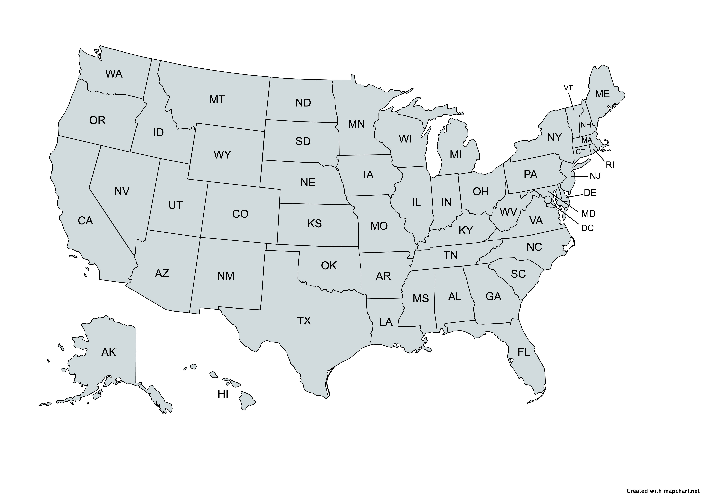
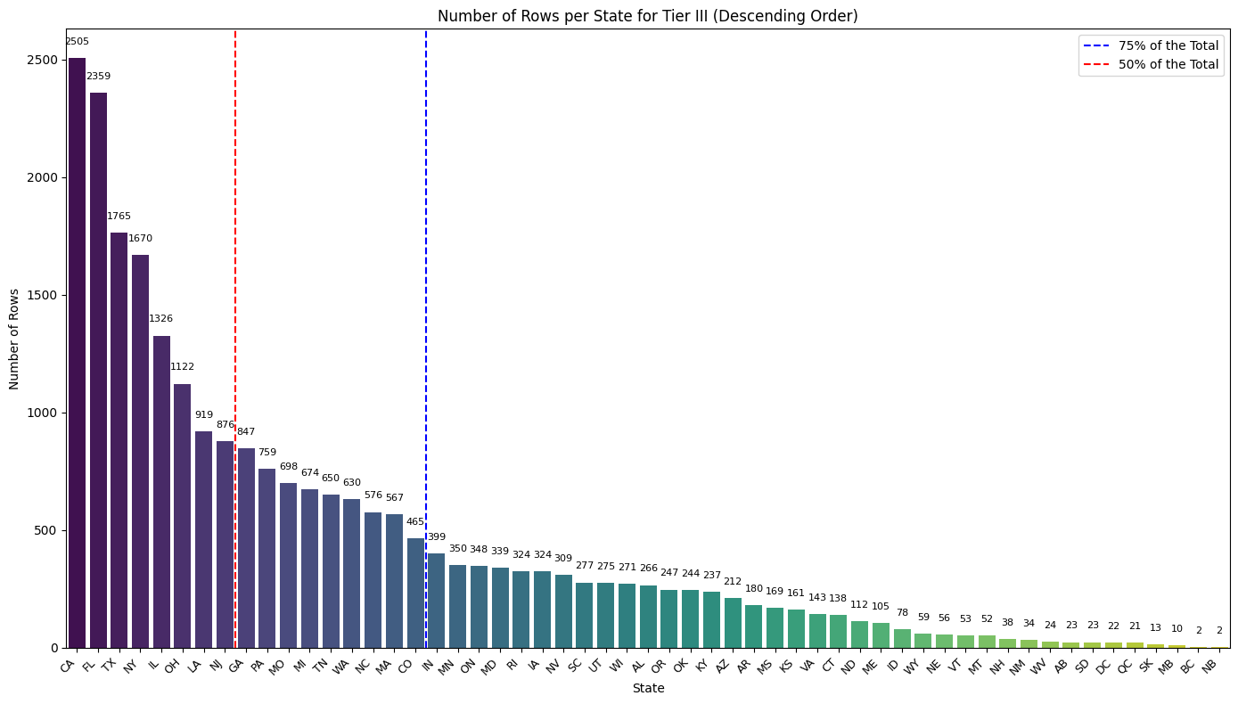
Company | Tier Analysis | Geographic | Company
Customer Name
Customer #
Tier
State
Avg. Time On Dock (in hours): | 3 | State Avg. Time On Dock (in hours): | 3
Avg. Lbs Per Period: | 311,500 | State Avg. Lbs Per Period: | 311,500
Avg. # Of POs Per Load: | 2.9 | State Avg. # Of POs Per Load: | 2.9
Avg. Cases Per Load: | 1,684 | State Avg. Cases Per Load: | 1,684
Avg. Lines Per Load: | 182 | State Avg. Lines Per Load: | 182
Avg. Cases Per Line: | 9 | State Avg. Cases Per Line: | 9
Avg. % Item Spread: | 4% | State Avg. % Item Spread: | 4%

Slide 4
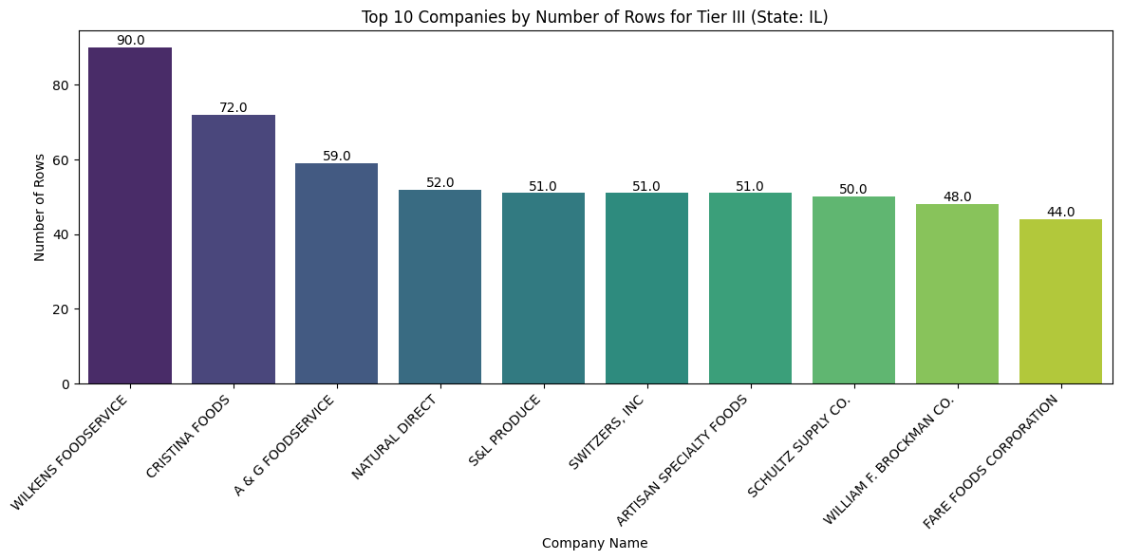
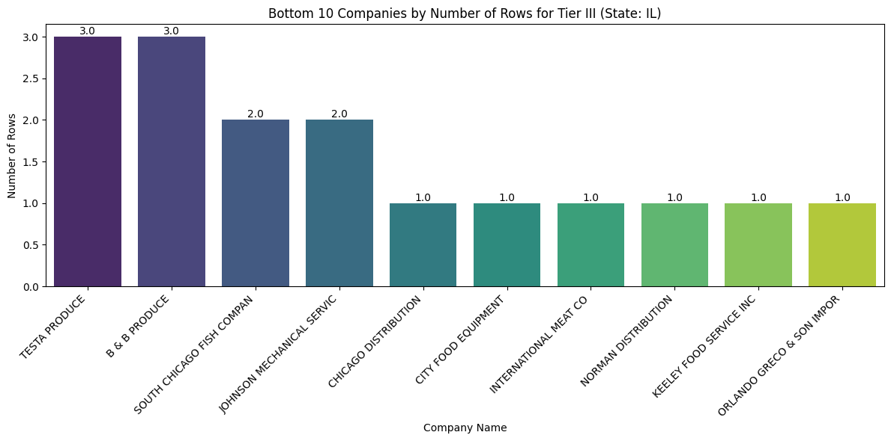
Company | Tier Analysis | Geographic | Company
Customer Name
Customer #
Tier
State
Avg. Time On Dock (in hours): | 3 | State Avg. Time On Dock (in hours): | 3
Avg. Lbs Per Period: | 311,500 | State Avg. Lbs Per Period: | 311,500
Avg. # Of POs Per Load: | 2.9 | State Avg. # Of POs Per Load: | 2.9
Avg. Cases Per Load: | 1,684 | State Avg. Cases Per Load: | 1,684
Avg. Lines Per Load: | 182 | State Avg. Lines Per Load: | 182
Avg. Cases Per Line: | 9 | State Avg. Cases Per Line: | 9
Avg. % Item Spread: | 4% | State Avg. % Item Spread: | 4%

